Slide 1
Macroeconomics ECO 4101 (E)
Summer 2025

Slide 2
Lecture 1
Chapter 23
Basic Concepts of Macroeconomics

Slide 3
The subject matter of Economics is divided into two broad categories:
Microeconomics
Macroeconomics
Microeconomics is the study of how individual households and firms make decisions and how they interact with one another in markets.
Macroeconomics is the study of the economy as a whole.
Macroeconomists address diverse questions, for example:
Why is average income high in some countries while it is low in others?
Why do prices sometimes rise rapidly while at other times they are more stable?
What can the government do to promote rapid growth in incomes, low inflation, and stable employment?
These questions are all macroeconomic in nature because they concern the workings of the entire economy.

Slide 4
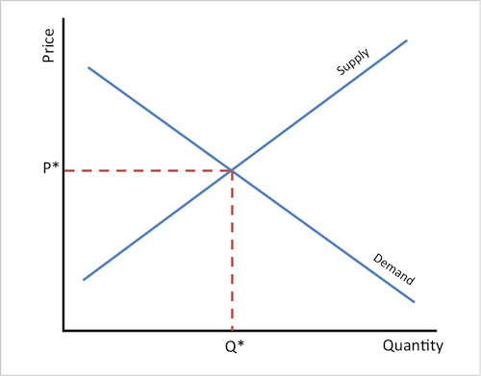
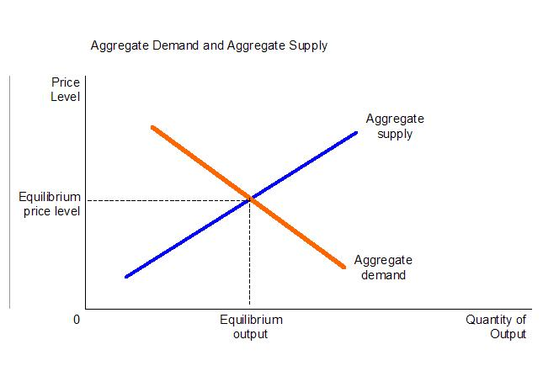
Microeconomics & Macroeconomics are closely linked:
Because the economy as a whole is a collection of many households and many firms interacting in many markets, microeconomics and macroeconomics are closely linked. The basic tools of supply and demand, for instance, are as central to macroeconomic analysis as they are to microeconomic analysis.

Slide 5
Objectives and Instruments of Macroeconomics:
How do economists evaluate an economy’s overall performance? What are the tools that governments can use to pursue their economic goals?
Measuring the performance of the economy: The major macroeconomic goals are a high level and rapid growth of output, low unemployment, and stable prices.
Output:
The ultimate objective of economic activity is to provide the goods and services that the population desires. The most comprehensive measure of the total output in an economy is the gross domestic product (GDP). GDP is the measure of the market value of all final goods and services produced in an economy at a certain period of time usually one fiscal year.

Slide 6
High Employment, Low Unemployment:
Of all the macroeconomic indicators, employment and unemployment are most directly felt by individuals. People want to be able to get high-paying jobs without searching or waiting too long, and they want to have job security and good benefits. In macroeconomic terms, these are the basic objectives of high employment, which is the counterpart of low unemployment.
The unemployment rate tends to reflect the state of the business cycle: when output is falling, the demand for labor falls and the unemployment rate rises. Unemployment reached epidemic proportions in the Great Depression of the 1930s, when as much as one-quarter of the workforce was idled.

Slide 7
Price Stability:
The third macroeconomic objective is price stability. This is defined as a low and stable inflation rate. The inflation rate is the percentage change in the overall level of prices from one year to the next.
To track prices, government statisticians construct price indexes, or measures of the overall price level. An important example is the consumer price index (CPI), which measures the trend in the average price of goods and services bought by consumers.
To summarize:
The goals of macroeconomic policy are:
1. A high and growing level of national output
2. High employment with low unemployment
3. A stable or gently rising price level

Slide 8
The Tools of Macroeconomic Policy:
Governments have certain instruments that they can use to affect macroeconomic activity.
A policy instrument is an economic variable under the control of government that can affect one or more of the macroeconomic goals.
By changing monetary, fiscal, and other policies, governments can avoid the worst excesses of the business cycle or increase the growth rate of potential output.
This mean an economy has two major kinds of policies that can
be used to pursue its macroeconomic goals—
Fiscal policy
Monetary policy.

Slide 9
Fiscal Policy
Fiscal policy consists of government expenditure and taxation. Government expenditure influences the relative size of collective spending and private consumption. Taxation increases private saving. In addition, it affects investment and potential output. Fiscal policy is primarily used to affect long-term economic growth through its impact on national saving and investment; it is also used to stimulate spending in deep or sharp recessions.
Monetary Policy
Monetary policy, conducted by the central bank, determines short-run interest rates. It thereby affects credit conditions, including asset prices such as stock and bond prices and exchange rates. Changes in interest rates, along with other financial conditions, affect spending in sectors such as business investment, housing, and foreign trade. But the most important impact is on price level.

Slide 10
The Circular Flow Model:
The circular flow model describes all the transactions between households and firms in a simple economy.
It simplifies matters by assuming that all goods and services are bought by households and that households spend all of their income.
In this economy, when households buy goods and services from firms, these expenditures flow through the markets for goods and services.
When the firms in turn use the money they receive from sales to pay workers’ wages, landowners’ rent, and firm owners’ profit, this income flows through the markets for the factors of production.
Money continuously flows from households to firms and then back to households.

Slide 11
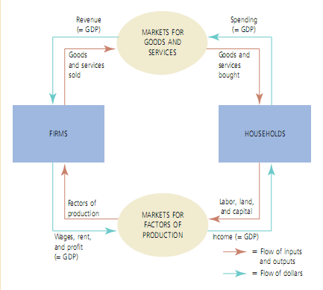
Figure : Circular Flow of National Income

Slide 12
The circular flow model of national income and expenditure is a fundamental representation of the macroeconomic activity between the major players in the economy: Consumers and Producers
The various components of national income and expenditure (revenue, spending, factor payments) are shown in the diagram in such a manner that national income equals national expenditure.
In this model the consumers (household sector) provides various factors of production such as land, labor, capital to producers (Firms) who produce goods and services by coordinating them.
Producers or firms in return makes payment in the form of rent, wages, interest and profits to the household sector.
Again household sector spends this income to fulfill its wants in the form of consumption expenditure. Producers supplies them goods and services produced and gets income in return of it.

Slide 13
Thus expenditure of one sector becomes the income of the other. Similarly the supply of goods and services by one sector of the economy becomes the demand for the other sector. That is according to the circular flow model we can conclude that:
National Income = National Expenditure
This process is unending and forms the circular flow of income and expenditure.

Slide 14
Macroeconomic Equilibrium:
Aggregate supply and demand curves are often used to help analyze macroeconomic conditions.
Aggregate Supply: Aggregate supply refers to the total quantity of goods and services that the economy’s businesses willingly produce and sell in a given period. Aggregate supply (often written AS) depends upon the price level, the productive capacity of the economy, and the level of costs.
Aggregate Demand: aggregate demand refers to the total amount that different sectors in the economy willingly spend in a given period. Aggregate demand ( often written AD ) equals total spending on goods and services. It depends on the level of prices, as well as on monetary policy, fiscal policy, and other factors.

Slide 15
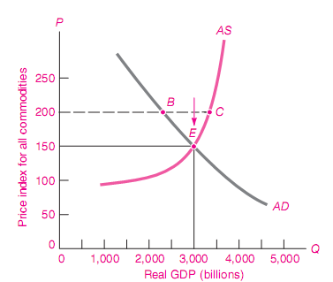
Figure: Aggregate Demand Supply Equilibrium
National output and the overall price level are determined at the intersection of the aggregate demand and supply curves, at point E. This equilibrium occurs at an overall price level where firms willingly produce and sell what consumers and other demanders willingly buy.

Slide 16
Lecture 2
Measuring National Income

Slide 17
National Income:
National income is the money value of output of goods and services produced within an economy over a period of time. Measuring the level and rate of growth of national income is important in order to understand the rate of economic growth.
There are several measures of National Income, but the most widely used measures are: GDP and GNP

Slide 18
Gross Domestic Product (GDP):
Gross domestic product (GDP) is the market value of all final goods and services produced within a country in a given period of time.
“GDP is the Market Value . . .”
GDP adds together many different kinds of products into a single measure of the value of economic activity. To do this, it uses market prices. Because market prices measure the amount people are willing to pay for different goods, they reflect the value of those goods and also the contribution of the good in GDP.
For Example: If the price of an apple is twice the price of an orange, then an apple contributes twice as much to GDP as does an orange.

Slide 19
“. . . of All . . .”
It includes all items produced in the economy & sold legally in markets.
For Example: GDP measures the market value of apples and oranges, books and movies, haircuts and healthcare, and on and on.
GDP also includes the market value of the housing services. For rental housing, GDP includes the value of rent where rent equals both the tenant’s expenditure and the landlord’s income.
But if people own the place where they live and, therefore, do not pay rent, then the government includes this owner-occupied housing in GDP by estimating its rental value.
Which goods are not included the calculation of GDP:
There are some products, however, that GDP excludes because measuring them is so difficult.
1. Unreported Activities: GDP excludes most items produced and sold illicitly, such as illegal drugs.

Slide 20
2. Non market goods and services: It also excludes most items that are produced and consumed at home and, therefore, never enter the marketplace.
For example, Vegetables you buy at the grocery store are part of GDP; vegetables you grow in your garden are not.
“. . . Final . . .”
GDP includes only the value of final goods. This is done because the value
of intermediate goods is already included in the prices of the final goods. Adding the market value of the intermediate good to the market value of the final good would be double counting. That is, it would (incorrectly) count the intermediate good twice as the value addition of the intermediate goods are already included in the value of final good
For example:
Suppose the market value of bread is 70 TK
Farmer Miller Baker seller
(Wheat) (Flour) (Bread)
20 30 65 70
Here , wheat and flour is intermediate goods

Slide 21
“. . . Goods and Services . . .”
GDP includes both tangible goods (food, clothing, cars) and intangible services (haircuts, housecleaning, doctor visits).
“. . . Produced . . .”
GDP includes goods and services currently produced. It does not include transactions involving items produced in the past.
For example:
When Ford produces and sells a new car, the value of the car is included in GDP. When one person sells a used car to another person, the value of the used car is not included in GDP.
“. . . Within a Country . . .”
GDP measures the value of production within the geographic boundaries of a country. GDP includes the output of foreign owned business that are located in the country. Thus, items are included in a nation’s GDP if they are produced domestically, regardless of the nationality of the producer.

Slide 22
“. . . In a Given Period of Time.”
GDP measures the value of production that takes place within a specific interval of time. Usually, that interval is a year or a quarter (three months). GDP measures the economy’s flow of income and expenditure during that interval.
Methods of Calculating GDP:
Income Method: Adding up the income of all consumers, producers income of government and the foreigners in the domestic economy.
Expenditure Method: Adding up the expenditure of all consumers, producers, the government and foreigners on good and services made in the domestic economy.
NOTE: According to the circular flow model GDP calculated by income method must be equal to the GDP calculated by expenditure method. Because all expenditure in the economy ends up as someone’s income, GDP is the same regardless of how we compute it.

Slide 23
But…..
In real life we can see that The two ways of calculating GDP give almost exactly the same answer.
Why “almost”? Although the two measures should be precisely the same, data sources are not perfect. The difference between the two calculations of GDP is called the statistical discrepancy.)
Components of GDP:
GDP (denoted by Y) is divided into four components: consumption (C), investment (I), government purchases (G), and net exports (NX).
Y = C + I + G + NX.
Consumption: Consumption is spending by households on goods and services, with the exception of purchases of new housing. Goods include household spending on durable goods, such as automobiles and appliances, and nondurable goods, such as food and clothing. Services include such intangible items as haircuts and medical care.

Slide 24
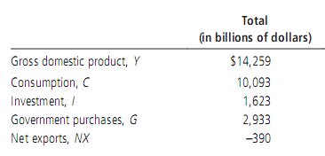
Investment : Investment is the purchase of goods that will be used in the future to produce more goods and services. It is the sum of purchases of capital equipment, inventories, and structures.
Government Purchases: Government purchases include spending on goods and services by local, state, and federal governments. It includes the salaries of government workers as well as expenditures on public works.
Net Exports: Net exports equal the foreign purchases of domestically produced goods (exports) minus the domestic purchases of foreign goods (imports).
This table shows total GDP for the U.S. economy in 2009 and the breakdown of GDP among its four components.

Slide 25
Real versus Nominal GDP:
GDP measures the total market value of all good and services in the economy. Now GDP increases from year to year , then at least
one of two things must be true:
the economy is producing a larger output of goods and services,
(2) or, goods and services are being sold at higher prices.
When studying changes in the economy over time, economists wants to separate these two effects. In particular, they want a measure of the total quantity of goods and services the economy is producing that is not affected by changes in the price. To do this, economists use a measure called real GDP.
Nominal GDP: Production of goods and services measured at current period’ market price.
Real GDP: Production of goods and services measured at a constant price/ base year’s price

Slide 26
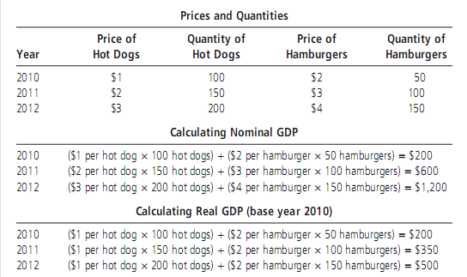
Example of GDP Calculation:

Slide 27
To sum up:
Nominal GDP uses current prices to place a value on the economy’s production of goods and services.
Real GDP uses constant base-year prices to place a value on the economy’s production of goods and services.
Because real GDP is not affected by changes in prices, changes in real GDP reflect only changes in the amount of production. Thus, real GDP is a measure of the economy’s production of goods and services.
Our goal in computing GDP is to measure how well the overall economy is performing. Because real GDP measures the economy’s production of goods and services, it reflects the economy’s ability to satisfy people’s needs and desires.
Thus, real GDP is a better measure of economic well-being than is nominal GDP.

Slide 28

GDP Deflator:
Nominal GDP reflects both the quantities of goods and services the economy is producing and the prices of those goods and services.
Holding prices constant at base-year levels, real GDP reflects only the
quantities produced.
From these two statistics, we can compute an another measure, called the GDP deflator, which reflects only the prices of goods and services.
The GDP deflator is calculated as follows:
Because nominal GDP and real GDP must be the same in the base year, the GDP deflator for the base year always equals 100.
The GDP deflator for subsequent years measures the change in nominal GDP from the base year that cannot be attributable to a change in real GDP.

Slide 29
The GDP deflator measures the current level of prices relative to the level of prices in the base year. So basically the GDP deflator reflects what’s happening to prices, not quantities.
GDP Deflator can be used to measure Inflation:
The GDP deflator is one measure that economists use to monitor the average level of prices in the economy and thus the rate of inflation. Using the GDP deflator, the inflation rate between two consecutive years is computed as follows:
It is called deflator because it can be used to take inflation out of nominal GDP—that is, to “deflate” nominal GDP for the rise that is due to increases in prices.

Slide 30

Example of GDP Deflator:

Slide 31
Is GDP a Good Measure of Economic Well-Being?
The Underground Economy: The gross domestic product misses many transactions that take place in the underground economy. The underground, gray, informal, or shadow economy involves otherwise legal transactions that go unreported or unrecorded.
GDP is not, however, a perfect measure of well-being. Some things that contribute to a good life are left out of GDP.
Because GDP uses market prices to value goods and services, it excludes the value of almost all activity that takes place outside markets.
Another thing that GDP excludes is the quality of the environment. GDP reflects the factory’s production, but not the harm that it inflicts on the environment.
GDP does not capture the income inequality exits in the economy.

Slide 32

Per Capita GDP:
One of the main use of national income is in measuring the economic well being of the population through the concept of the standard of living. Per capita GDP is particularly helpful in measuring the standard of living.
Per capita GDP =
Per capita GDP is used when comparing one country to another because it shows the relative performance of the countries. A rise in per capita GDP signals growth in the economy and tend to translate as an increase in productivity.

